Slide 1
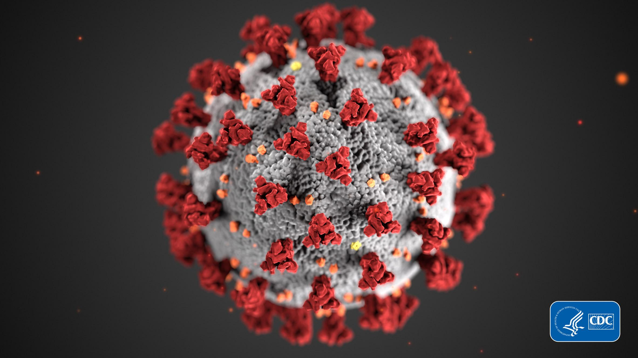
Covid-19 Tracker
Michael Brewer, Ryley Tierney, Barry Sly-Delgado, Ryan Frazier

Slide 2
Final Requirements and comparison with initial requirements
Final Requirements:
Create, delete, and edit Personal account.
Display Data about covid-19 Infections using API
View Symptoms of covid-19 (linked to outside sources)
Hash passwords
Initial Requirements:
Display Heatmap of the infection rate of covid-19
Search for nearby testing centers
View Symptoms of covid-19 (linked to outside sources)

Slide 3
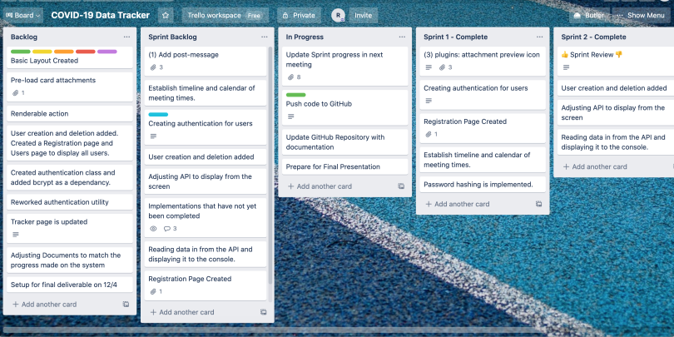
Final timeline and comparison with the initial timeline
Initial timeline separated into 3 Sprints
Final timeline separated into 2 Sprints
Unforeseen circumstances constrained timeline
Changed timeline so that sprints were not rushed

Slide 4
Project results compared with expectations
Originally sought to create a system that analyzes symptoms of covid-19, and give a diagnosis
Decided to scale down the system after further research into implementing initial features
Focused on Using API to track covid cases
Notes:
The use case on the left is within the scope of this project (for what we have planned so far). The use case on the right is for a more advanced real world application that has multiple dependencies. Mention how we would like to build up to the use case on the right.

Slide 5
Project process review
Overall, the process went smoothly. Between sprint sessions the members would meet on Wednesdays and Fridays to discuss the project and requirements. The following is a quick outline of the process.
Assign team roles
Group meetings scheduled
Individual plan
Group plan
Sprint 1
Sprint 2

Slide 6
Work to be done
Implement Maps of Covid Hot zones
Allow Users to search for covid Testing centers near them
Improve site layout
Show sources for reports and symptoms
Implement locations

Slide 7
DEMO

